Slide 1


Slide 2
Who Are We
The Export Credit Guarantee Co. of Egypt has been incorporated in 1993 with a mandatory role of facilitating a healthy development of Egypt’s foreign trade, as well as supporting Egypt’s international trade strategy.
In achieving the above, ECGE provides comprehensive services and supports to Egyptian exporters to help them manage, protect and finance their receivables.

Slide 3
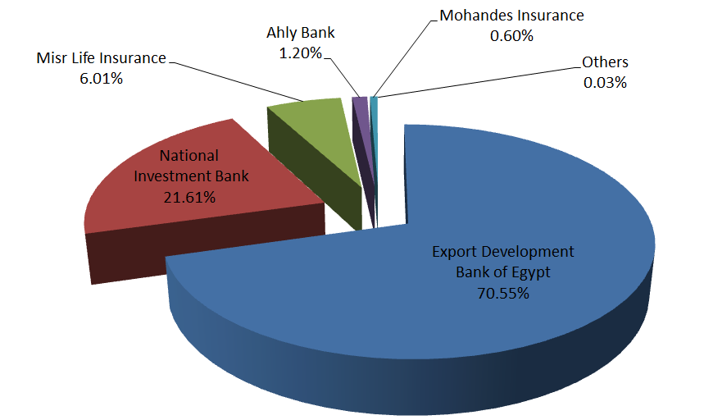
ECGE Ownership Structure

Slide 4
Mission
A global credit solution provider for Exporters providing
INFORMATION +CREDIT INSURANCE
+
FACTORING +DEBT RECOVERY.

Slide 5
Product Mix
Credit
Insurance
Factoring
Debt Collection & Credit Information
Foreign Investment Insurance
Short
Term
Medium Term
Protocol
Domestic
Credit
Insurance
Export Factoring
Import Factoring
Domestic Factoring

Slide 6
Strength
The “sole” player in the credit insurance business in Egypt .
Unique reinsurance arrangements with favorable treaties in place with two of the most prestigious players in the industry.
Provide factoring service .
Member in “Factor Chain International” with its tremendous network .
Member of the “Prague Club” and the “Credit Alliance” networks for credit insurers.

Slide 7

Strength
The “sole” player in the credit insurance business in Egypt .
Unique reinsurance arrangements with favorable treaties in place with two of the most prestigious players in the industry.
Provide factoring service .
Member in “Factor Chain International” with its tremendous network .
Member of the “Prague Club” and the “Credit Alliance” networks for credit insurers.

Slide 8
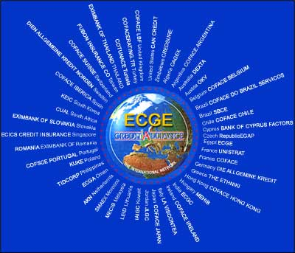
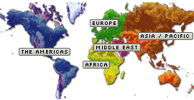
1-Credit alliance network
Credit Alliance
ECGE is maintaining solid strategic alliances with international networks.
97 credit insurers serving us around the world
In information and debt recovery

Slide 9






























































2-Factor Chain International
251 factors serving us around the world in risk cover and collection

Slide 10

3-Prague club
The Prague club was established in 1993 as part of the Berne Union network .It includes all the world credit insurers as members.

Slide 11
International Awards
International Awards Given:
FCI - Best Performance Improvement 2008
FCI - Best Performance Improvement 2009
Credit Alliance - Best Performance Improvement 2010
Credit Alliance - Middle East Coordinator 2009
Chairman of the Prague Club 2011

Slide 12
ECGE Credit Rating
ECGE was rated in 2010 by Middle East Rating and Investors Service “MERIS” – “A-”

Slide 13
Products & Services

Slide 14
Products & Services
  Credit Insurance
      Short Term
      Medium Term
  Export Factoring.
  Import Factoring
  Credit Information.
  Debt Recovery

Slide 15
Products
  Credit Insurance for goods and services
    Short & Medium Terms Credit Insurance:
      Coverage of exports products for tenors up to one year against Commercial & Political risks
      Coverage of export services for tenors up to six months against Commercial & Political risk.
      Coverage of unconfirmed letters of Credit for banks for tenors up to one year.
      Coverage of Domestic sales of products for tenors up to one year
      Coverage of export products for tenors up to 7 years

Slide 16
The Protocol with the Government
    Under the Protocol signed with the Government, ECGE performs an advisory role to the Egyptian government regarding the government support directed to the Egyptian exports for medium term operations.
    Government becomes the reinsurer for operations covered by ECGE.

Slide 17

Benefits to Policy Holders
Protection against non-payment .
Expertise in assessment of credit and country risks .
Ability to develop new markets in different countries.
Increased market penetration.
Continual improvement in the quality of customers and therefore a lower incidence of bad debt .
Enhanced financing mechanisms by providing added security to finance providers.
Coverage of both medium term & short term credit risks to all world regions

Slide 18

ECGE & the Banks

Slide 19
ECGE & the Banks
ECGE compliments the banking services through:
    Providing security through the company policies enabling banks to finance exports including Cash Against Documents & Open Account operation
    Insuring unconfirmed letters of credit issued by foreign banks in high-risk regions to the Egyptian banks.
    Providing cover on high risk regions (Non marketable risks) where private insurers & Factors can not operate

Slide 20
Export Factoring
Exporter
Importer
Export Factor
Import Factor

Slide 21
Export Factoring
Exporter
Importer
List of Buyers
Credit Covers
Credit Covers
Export Factor
Import Factor
Credit Applications

Slide 22
Export Factoring
Goods and Invoice
Exporter
Importer
Invoice Copy
Payment
Collection/
Payment
Invoice Data
Export Factor
Import Factor
Payment

Slide 23
Deliverables
Sales Ledger Administration
Collection
Financing
Credit Risk Protection
complete debtor administration
reminders and legal collection
advance finance at shipment
if buyer does not pay – we pay

Slide 24
Benefits to the Exporter (Seller)
Simple procedures and documentation which is easy to apply even for new Exporters.
Increased sales in foreign markets by offering competitive terms and conditions of payment.
Credit lines are in place for importers, which speed up response time for orders and re-orders.
Protection against credit losses.
Efficient collection of proceeds without delay.
Elimination of delays so often encountered in the negotiation of Letters of Credit.

Slide 25
Benefits to the Exporter (Seller)
Language difficulties are handled by the Export Factor and Import Factor.
Access to a flexible source of working capital, in local or invoiced currency, geared to export sales.
Factored receivables if non recourse are considered an off balance sheet item which enhance the financial and credit position of the Exporter

Slide 26
Import Factoring
An exporter presents a request to his factor abroad to discount invoices drawn on an Egyptian importer
The export factor request from ECGE to guarantee the Egyptian importer & collect the debt from him
ECGE as an Import Factor covers the risk of the Egyptian importer to the foreign export factor, collects the debt & transfer it to the factor
If the Egyptian importer doesn’t pay, ECGE pays an indemnity to the foreign factor

Slide 27
Benefits to the Importer (Buyer)
Increased purchasing power without using existing credit lines.
Goods can be bought without incurring the delays, complications and cost of opening Letters of Credit.

Slide 28
Buyer Information Report Services
Horizontally integrating the services provided by the company to its customers
Enables exporters to obtain information regarding their clients
Future business planning to avoid high risks

Slide 29
Debt Recovery Services
Debt recovery for uninsured debts
Networks of debt collectors to monitor & recover overdue accounts
New levels of efficiency & control for our exporters with overseas buyers through avoiding losses

Slide 30
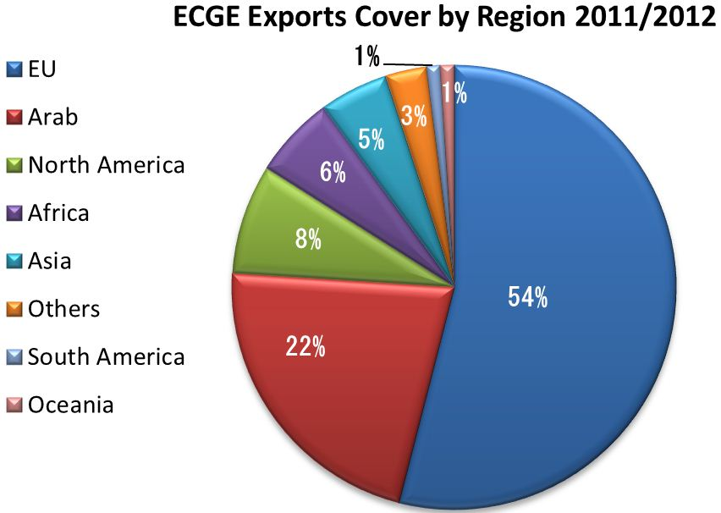

Slide 31
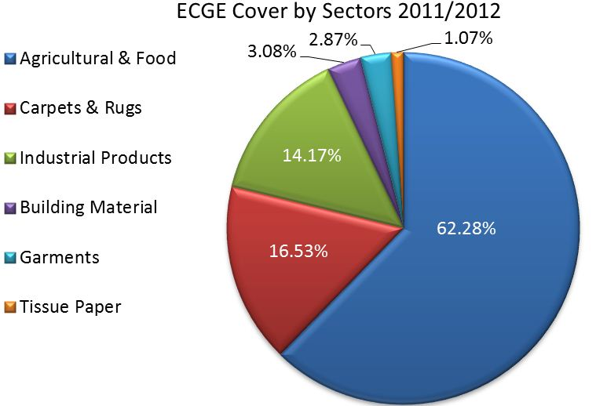

Slide 32
For Further Information
Tel: +202 22636745
+202 22636762
Fax: +202 22636825
E-mail: ecgegypt@ecgegypt.net
Website: ecgegypt.net
Address: 5 El Nasr Road., Nasr City, Cairo, Egypt

