Slide 1
Emergence of Agriculture Insurance in Africa and Success Stories Erastus Ndege OCHIENG’ 24th September 2018 Cairo
AGRICULTURE INSURANCE SEMINAR - CAIRO

Slide 2
GLOBAL AND CONTINENTAL PERSPECTIVES

Slide 3
Introduction
Agriculture is the main economic activity in most African Countries contributing greatly to GDP and is the main source of livelihood for a majority of the populace.
Over 70%of Africa`s population rely on agriculture for survival and yet less than 1% are protected from production disruptions through insurance.
Farmers are faced by quite a number of risks which always render them vulnerable and at times leading to poverty traps.
The growth of agriculture insurance in Africa is still on the formative stages with great potential for growth
Most governments are beginning to consider insurance as an efficient and effective way of addressing catastrophe social protection measure.
3

Slide 4
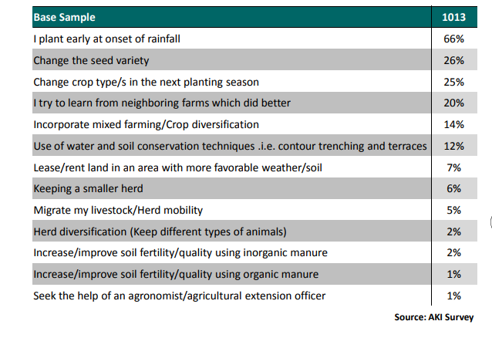
In spite of the risks famers face, Insurance is not among the coping mechanisms they prioritize on
4
Notes:
Largely insurance not being a tangible product, makes it not so appealing to the farmers. This coupled with the misconceptions about insurance and general ignorance.

Slide 5
Evolution of Agriculture Insurance
1920-1938
Federal Crop Insurance Act
(USA)
1981
Revenue Insurance
1993
Area Yield Insurance Pilot in 1993 based on 1990 farm act in USA
2004
Index - India
1791
Crop Hail Insurance in Germany
There has been a lot of activities in the recent past on agriculture insurance with innovations on index based crop and livestock insurance, the use of satellite index insurance products and exploration on the use of drone technology
5

Slide 6
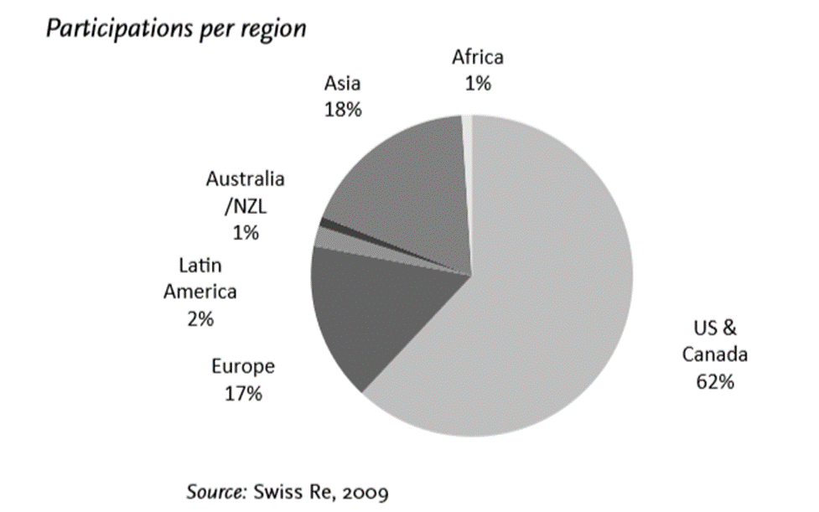
Distribution of total written premium globally
Source: World Bank 2009
As at 2017, the total premium volume for Africa stood at approximately USD 250million out of which estimates show USD 150million was from South Africa and the rest from the other countries i.e. Morocco, Zambia, Zimbabwe, Algeria, Tunisia, Kenya, Ethiopia as some of the key contributors
6

Slide 7
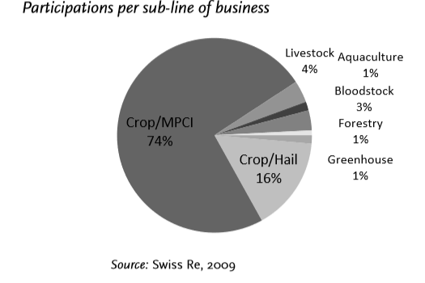
Distribution by product globally
Source: World Bank 2009
Crop insurance is the most developed line accounting for about 90% of the written premium worldwide.
MPCI dominant in the USA and Canada, Named peril dominant in Europe. Africa Hail Insurance in South Africa
7

Slide 8
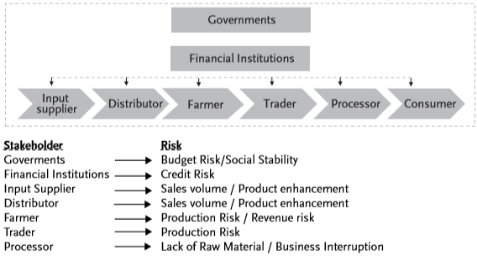
DRIVERS FOR AGRICULTURE INSURANCE
8

Slide 9
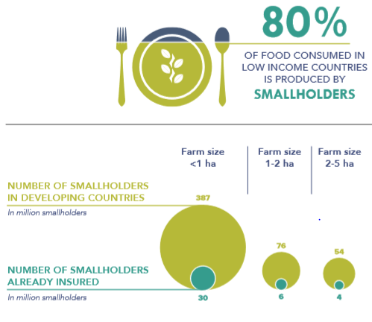
DRIVERS FOR AGRICULTURE INSURANCE IN AFRICA
9

Slide 10
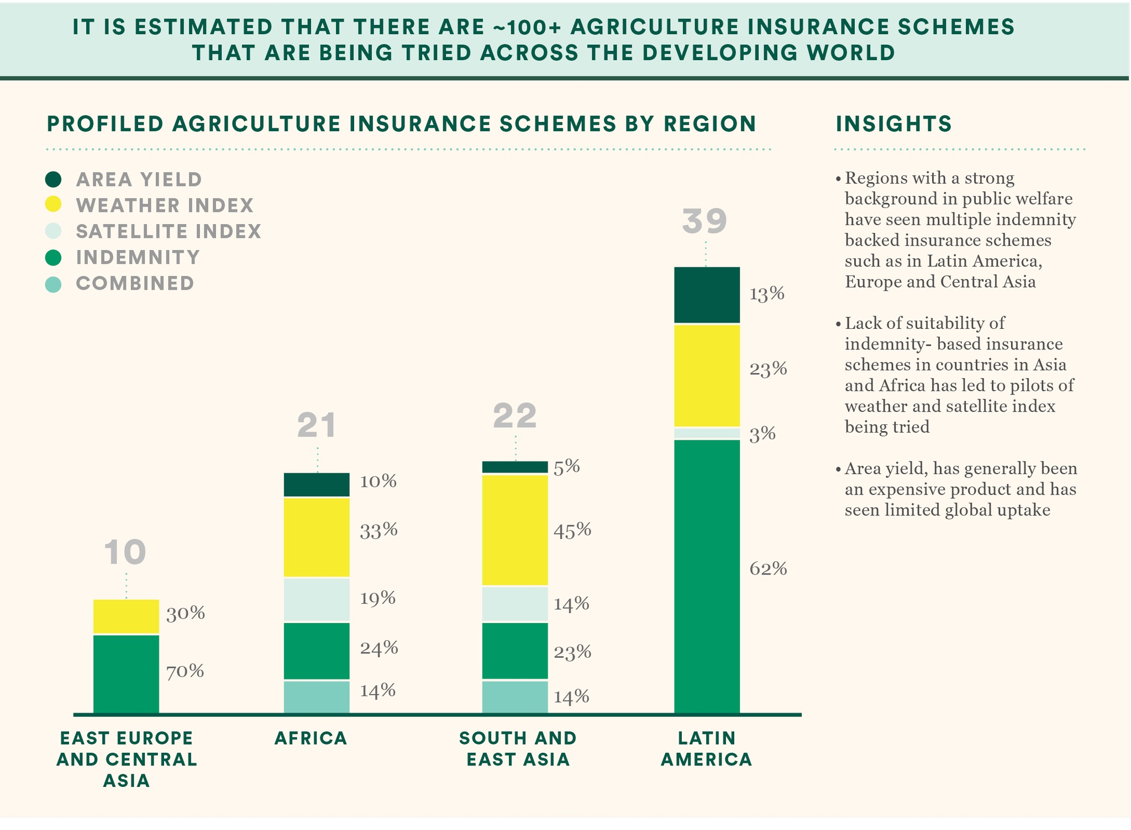
Source: ISF
2018
10

Slide 11
Sources: Global Index Insurance facility’s country reports
ILRI website
11

Slide 12
Synergies between private sector players, government and development organizations towards the development of the insurance environment are key towards growth
12

Slide 13
KEY SUCCESS STORIES

Slide 14
ACRE AFRICA
Started operations in 2009 as a project run by the Syngenta Foundation for Sustainable Development in partnership with UAP Insurance.
The program later developed to a scheme known as “Kilimo Salama” in 2010.
With continual growth it formed into a social business in 2014, transforming to the currently known “ACRE Africa”
It is the first agricultural insurance project worldwide to reach farmers by the use of mobile phones
Farmers purchase insurance together with the farming inputs from local stockists along at an affordable premium on the retail price. Premiums are subsidised by input manufacturing companies who match the premium paid by the farmer.
Development organizations like the International Finance Corporation have previously also offered subsidies either as a direct rebate to the insurance or to minimize the distribution costs
Operations: Kenya, Rwanda, Tanzania
Products: Index Based Weather Insurance, Index Based Satellite Insurance, Area Yield Index Insurance, Hybrid of Index Based and Area Yield Insurance
Contracts Sold: 1.6 million as per 2017 estimates up from 200 farmers in 2009 when they launched
Success factors: Effective partnerships, Use of technology, Low Cost Distribution channels
14

Slide 15
ACRE AFRICA
Development organisations
Syngenta Foundation
Government Agencies
Weather Monitoring partners
Private Sector
Insurance Companies
Distribution channels
SACCOs
International Finance Cooperation
Lundin Foundation
Financial Institutions
Input Manufacturers
Min. of Agriculture
Mobile Network Operators
Agrovets
15

Slide 16
INDEX BASED LIVESTOCK INSURANCE (IBLI)
Piloted in 2010 in Marsabit Kenya by the International Livestock Research Institute after 3 years of research activities.
Later expanded to other regions in Northern Kenya and Southern Ethiopia (Borana region)
Product offered is a pasture Vegetative Index Insurance that protects pastoralist farmers against lack of pasture as a result of drought
As from 2016, the government of Kenya entered into a partnership with insurance companies to offer subsidies to the most vulnerable households. As from 2018, there is a partial subsidy introduced targeting those not targeted with the full subsidy
Success Factors: Effective partnerships, Innovative index, Low transaction costs due to reduced loss monitoring and contract enforcement costs through satellite technology
16

Slide 17
IBLI
Development organizations
International Livestock Research Institute
Government Agencies
Weather Monitoring partners
Private Sector
Distribution channels
World Vision
Financial Institutions
SACCOS
State Department of Livestock
Index Insurance Innovation Initiative
Oromiya Pastoral Area Development Commission
Mercy Corps
Solidarites International
DFID
USAID
AusAID
Insurance Companies
17

Slide 18
FARMER INPUT SUPPORT PROGRAM (FISP)
Product offered by the government of Zambia piloted in 2017
The Insurance program built on an infrastructure that had been developed by the government where farmers receive input subsidies through an e-voucher system
Payments are automatically triggered to the e-voucher based on comparison between satellite data and the weather index
The product developed is a satellite based index insurance product
Figures:
Total number of farmers covered are 1,059,214
Premium – USD 10 million
Claim at end of season – USD 5.8 million
Number of farmers compensated – 424,954
18

Slide 19
FISP
Development organizations
Global Index Insurance Facility
Government Agencies
Ministry of Agriculture
Private Sector
Insurance Companies - Mayfair
Distribution channels
E-Voucher vendor
Risk Shield
Government Extension workers
World Food Program
Government through FISP program
19

Slide 20
KEY LESSONS
Partnerships are key in the scale up of agriculture insurance to small scale farmers in Africa – PPP models
Governments play a key role in stimulating demand either through introduction of subsidy programs or creation of an enabling environment for business growth by implementing enabling policies, supporting distribution systems, and awareness creation.
Technology and Digitization is a key driver in the distribution channel whether through Mobile Network Operators, Financial Institutions, Mobile Wallets.
Innovations will be key enablers of the next growth frontiers. Technologies like the use of drones, soil sensor indices, Blockchain and Artificial Intelligence technologies
New non traditional distribution systems open up new markets. Examples include seed companies, development organizations like the World Food Program, Social Programs like the One Acre Fund etc
20

